Slide 1
No Hassle NoSQL – Introduction to DynamoDB
Pradyumna Dash
Solutions Architect, Amazon Web Services

Slide 2
DynamoDB Fully managed nonrelational database for any scale
Fully managed
Security
Durability
Availability
Adaptive capacity
Maintenance free
Global tables
DynamoDB Streams
Time To Live
Performance at scale
Single-digit millisecond response
Consistent perf at any scale
Virtually unlimited throughput
Secondary indexes
Flexible data model
Enterprise ready
Encryption at rest and transit
Fine-grained access control
99.99% service level agreement
Backup and restore

Slide 3
Fully managed Maintenance free
Think of all the other things you could do if you didn’t have to manage:
Security
Operating system patching
Database patching
Access control
Audit
Encryption
Compliance
Availability
High availability configuration
Monitoring
Cross-region replication
Performance
Performance tuning
Indexing
In-memory caching
Durability
Sustain server, rack, and datacenter outages
Re-replicate data quickly upon hardware failure
Manage backup and restore
Scalability
Capacity planning
Host provisioning
Host repair and retirement

Slide 4










































Amazon DynamoDB More than 100,000 Customers

Slide 5
Why NoSQL?
SQL
NoSQL
Optimized for storage | Optimized for compute
Normalized/relational | Denormalized/hierarchical
Ad hoc queries | Instantiated views
Scale vertically | Scale horizontally
Good for OLAP | Built for OLTP at scale

Slide 6
Table
Table
Items
Attributes
Partition Key
Sort Key
All items for key
==, <, >, >=, <=
“begins with”
“between”
“contains”
“in”
sorted results
counts
top/bottom N values
Mandatory
Key-value access pattern
Determines data distribution
Optional
Model 1:N relationships
Enables rich query capabilities

Slide 7
Partition Keys
Partition Key uniquely identifies an item
Partition Key is used for building an unordered hash index
Allows table to be partitioned for scale
Id = 1
Name = Jim
Id = 2
Name = Andy
Dept = Eng
Id = 3
Name = Kim
Dept = Ops
Hash (1) = 7B
Hash (2) = 48
Hash (3) = CD
00
Key Space
00
54
55
A9
AA
FF
FF

Slide 8
Partition:Sort Key
Partition:Sort Key uses two attributes together to uniquely identify an Item
Within unordered hash index, data is arranged by the sort key
No limit on the number of items (∞) per partition key
Except if you have local secondary indexes
00:0
Partition 1
54:∞
55
Partition 2
A9:∞
AA
Partition 3
FF:∞
Customer# = 2
Order# = 10
Item = Pen
Customer# = 1
Order# = 10
Item = Toy
Customer# = 3
Order# = 10
Item = Book
Customer# = 2
Order# = 11
Item = Shoes
Customer# = 1
Order# = 11
Item = Boots
Customer# = 3
Order# = 11
Item = Paper
Hash (2) = 48
Hash (1) = 7B
Hash (3) = CD

Slide 9
Partitions are three-way replicated
Id = 2
Name = Andy
Dept = Engg
Id = 1
Name = Jim
Id = 3
Name = Kim
Dept = Ops
Replica 1
Id = 2
Name = Andy
Dept = Engg
Id = 1
Name = Jim
Id = 3
Name = Kim
Dept = Ops
Replica 2
Id = 2
Name = Andy
Dept = Engg
Id = 1
Name = Jim
Id = 3
Name = Kim
Dept = Ops
Replica 3

Slide 10

Local Secondary Index (LSI)
Alternate sort key attribute
Index is local to a partition key
Table
A1 (partition) | A2 (sort) | A3 | A4 | A5
10 GB max per partition key, i.e. LSIs limit the # of range keys!
A1 (partition) | A3 (sort) | A2 (item key)
KEYS_ONLY
A1 (partition) | A4 (sort) | A2 (item key) | A3 (projected)
LSIs
INCLUDE A3
A1 (partition) | A5 (sort) | A2 (item key) | A3 (projected) | A4 (projected)
ALL

Slide 11
Global Secondary Index (GSI)
Online indexing
Alternate partition and/or sort key
Index is across all partition keys
Use composite sort keys for compound indexes
A1 (partition) | A2 | A3 | A4 | A5
RCUs/WCUs provisioned separately for GSIs
Table
A2 (partition) | A1 (itemkey)
KEYS_ONLY
GSIs
A5 (partition) | A4 (sort) | A1 (item key) | A3 (projected)
INCLUDE A3
A4 (partition) | A5 (sort) | A1 (item key) | A2 (projected) | A3 (projected)
ALL

Slide 12
Security

Slide 13
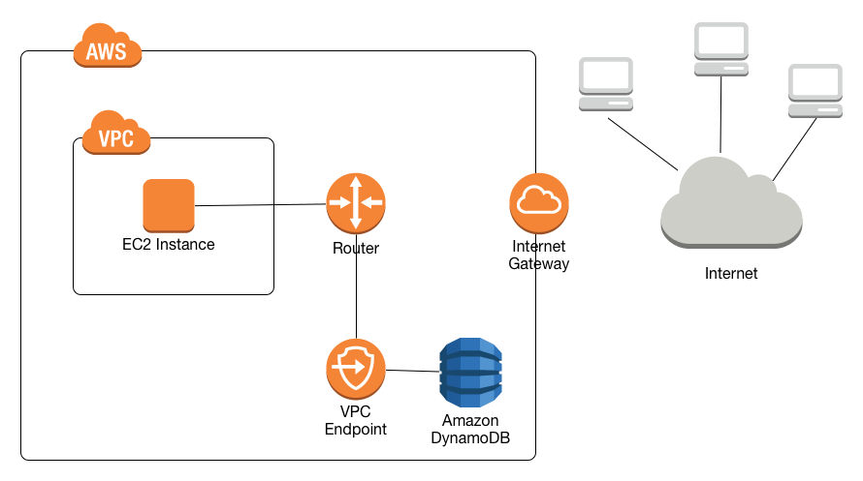
Amazon Virtual Private Cloud (Amazon VPC) Endpoints
Features
Access DynamoDB via secure Amazon VPC endpoint
Control access to tables via each VPC endpoint with unique IAM roles and permissions
Key Benefits
Turn off access from public internet gateways enhancing privacy and security
Fast, secure data transfer between Amazon VPC and DynamoDB

Slide 14


Amazon DynamoDB Encryption at rest
Support compliance certifications
Server-side
encryption
No application code rewrites
Table-level encryption
Same performance as an unencrypted table
Integrated with AWS KMS
Launched in February, available in 16 regions

Slide 15
Durability

Slide 16
Amazon DynamoDB – Back up and Restore
On-demand backups for long-term data archival and compliance
Point in time restore for short-term retention and data corruption protection
Backup hundreds of TB instantly with NO performance impact

Slide 17
Performance

Slide 18
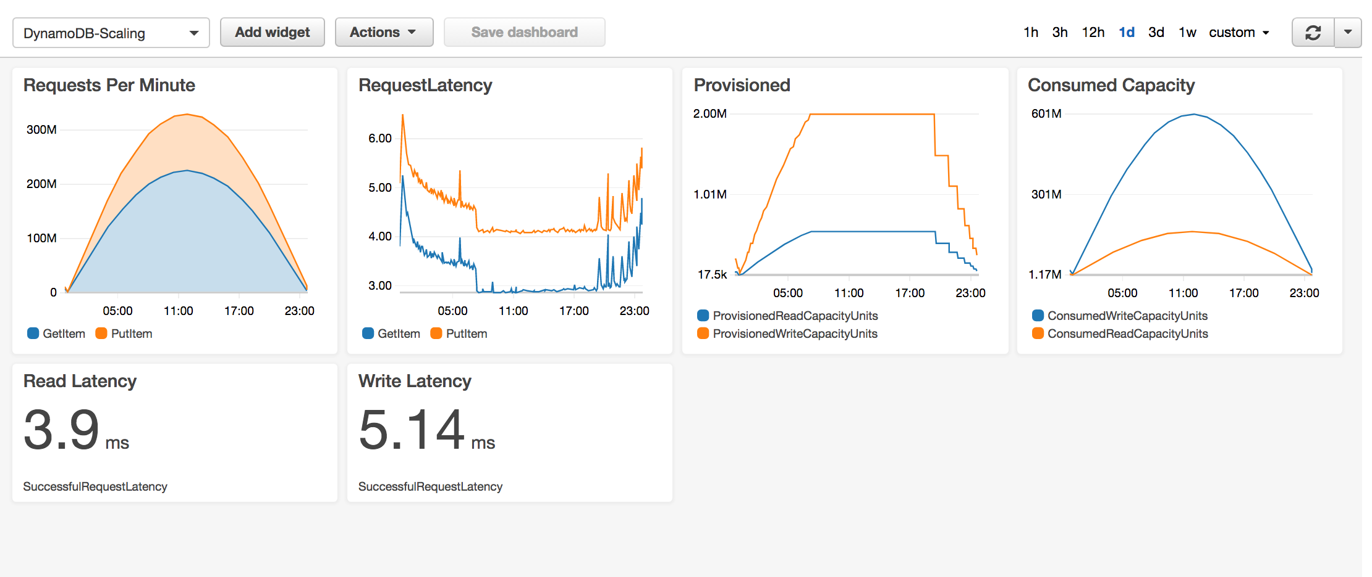
High performance
Millions of requests per second
Trillions of items
Petabytes of storage
Single-digit millisecond read and write latencies
Notes:
DynamoDB has experienced some extreme scale in real-world scenarios (e.g. Prime Day, Cyber Monday). Though many AWS customers will not require this level of scale, it is nice to know that DynamoDB is regularly battle hardened well beyond the requirements of your business. Ad-Tech applications typically require extremely low latency, which is well suited for DynamoDB’s low single digit millisecond read and write performance. Mobile applications and consumer voting applications often have millions of users and need to handle thousands of requests per second. DynamoDB can scale horizontally to meet this load. Finally, application monitoring solutions typically ingest hundreds of thousands of data points per minute, and DynamoDB’s schema-less data model, high IO performance and support for a native JSON data type is a great fit for these types of applications.

Slide 19
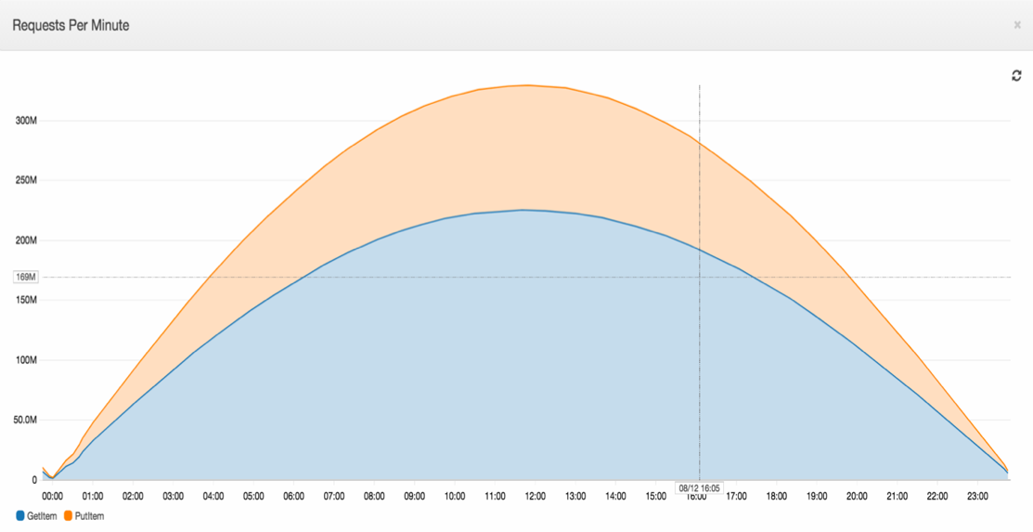
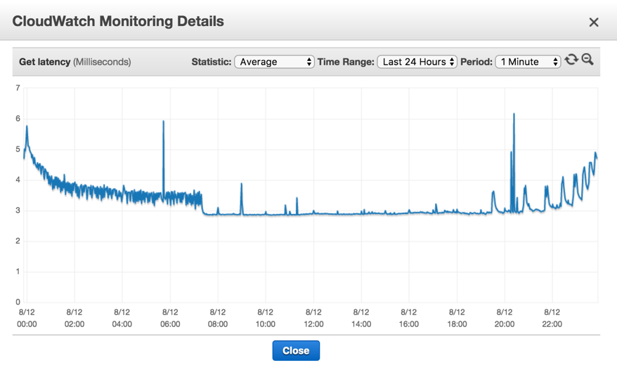
High performance
High request volume
Consistent and low latency
More than 1 million requests per second
Only 3 millisecond variance
Notes:
DynamoDB provides not only high throughput, but also consistent and predictable responsiveness. However, for some customers in Finance and AdTech, even milliseconds may not be good enough. We noticed they started using caching technologies, so we built them into DynamoDB.

Slide 20
Amazon DynamoDB Accelerator (DAX)
Features
Fully managed, highly available: handles all software management, fault tolerant, replication across multi-AZs within a region
DynamoDB API compatible: seamlessly caches DynamoDB API calls, no application re-writes required
Write-through: DAX handles caching for writes
Flexible: Configure DAX for one table or many
Scalable: scales-out to any workload with up to 10 read replicas
Manageability: fully integrated AWS service: Amazon CloudWatch, Tagging for DynamoDB, AWS Console
Security: Amazon VPC, AWS IAM, AWS CloudTrail, AWS Organizations
Notes:
Amazon DynamoDB Accelerator (DAX) is a fully managed, highly available, in-memory cache for DynamoDB, that delivers up to a 10x performance improvement—from milliseconds to microseconds—even at millions of requests per second. DAX does all the heavy lifting required to add in-memory acceleration to your DynamoDB tables, without requiring developers to manage cache invalidation, data population, or cluster management

Slide 21
Amazon DynamoDB Accelerator (DAX)
In-Memory performance and throughput
More than an order of magnitude faster!

Slide 22
Scalability

Slide 23
Scaling Storage: Time-to-live (TTL)
Features
Automatically delete items from a table based on expiration timestamp
User-defined TTL attribute in epoch time format
TTL activity recorded in DynamoDB Streams
TTL Attribute
ID | Name | Size | Expiry
1234 | A | 100 | 1456702305
2222 | B | 240 | 1456702400
3423 | C | 150 | 1459207905
Key Benefits
Reduce costs by deleting items no longer needed
Optimize application performance by controlling table size growth
Trigger custom workflows with DynamoDB Streams and Lambda.

Slide 24
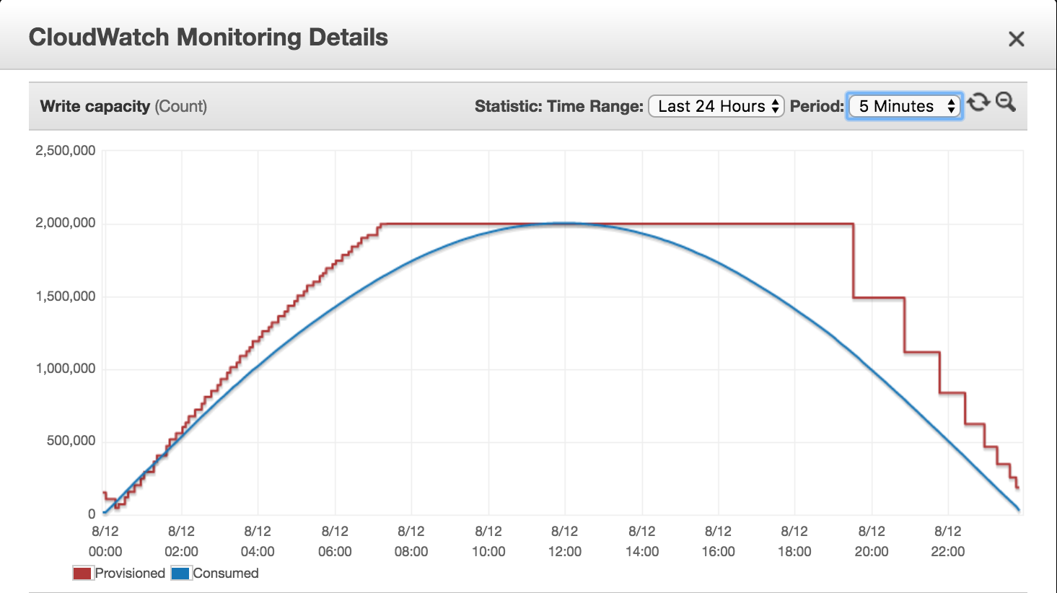
Scaling Throughput: Auto Scaling
$$$ Savings

Slide 25
Scaling Throughput: Auto Scaling
Fully-managed, automatic
Scale up when you need it
Scale down when you don’t
On by default
Scheduled Auto Scaling

Slide 26
Availability

Slide 27


Amazon DynamoDB Global Tables Fully managed, multi-master, multi-region database
Build high performance, globally distributed applications
Low latency reads & writes to locally available tables
Disaster proof with multi-region redundancy
Easy to setup and no application re-writes required

Slide 28
Amazon DynamoDB Service Level Agreement
Global Tables: 99.999%
Single-region Tables: 99.999
Available in all AWS regions worldwide
Terms and conditions are defined at https://aws.amazon.com/dynamodb/sla

Slide 29





Amazon DynamoDB
February 2017
April 2017
April 2017
June 2017
Time to Live (TTL)
VPC Endpoints
DynamoDB Accelerator (DAX)
Auto Scaling
November 2017
November 2017
February 2018
March 2018
Global Tables (GA)
On-demand Backup (GA)
Encryption at rest
Continuous
Backups

Slide 30
Common Adoption Patterns
NoSQL to DynamoDB
RDBMS to DynamoDB
Ease of Manageability
TCO
Fully Supported
Developer Flexibility
Scale
Performance

Slide 31

DynamoDB & Serverless
No Servers
No Administration
Highly Available
All AWS Regions
Extreme Scale
Consistent Performance
AWS Lambda Integration

Slide 32



Migrate to DynamoDB using AWS DMS
1. Non-Relational Databases
Minimal downtime
Secure
Replication support
2. Relational Databases
Amazon DynamoDB
DMS
3. Other sources
Amazon S3

Slide 33
Closing Thought…

Slide 34
Think of all the other things you can do
Security
OS Patching
DB Patching
Access Control
Audit
Encryption
Compliance
Durability
Sustain server, rack, and datacenter outages
Re-replicate data quickly upon HW failure
Manage backup & restore
Availability
High Availability Configuration
Monitoring
Cross-region Replication
Performance
Performance Tuning
Indexing
In-Memory Caching
Scalability
Capacity Planning
Host Provisioning
Host Repair & Retirement
If you let
Manage this all for you

Slide 35
THANK YOU!

